Slide 1
All I want for Christmas is you
Song BY: Mariah Carey
Made by: Pauline Borras

Slide 2
I don’t want a lot for Christmas
There is just one thing I need…
I don’t care about the presents
Underneath the Christmas tree
I just want you for my own
More than you could ever know
Make my wish come true oooh
All I want for Christmas
Is…………… you

Slide 3
I don’t want a lot for Christmas
There is just one thing I need, and I
Don't care about the presents
Underneath the Christmas tree
I don't need to hang my stocking
There upon the fireplace
Santa Claus won't make me happy
With a toy on Christmas day
I just want you for my own
More than you could ever know

Slide 4
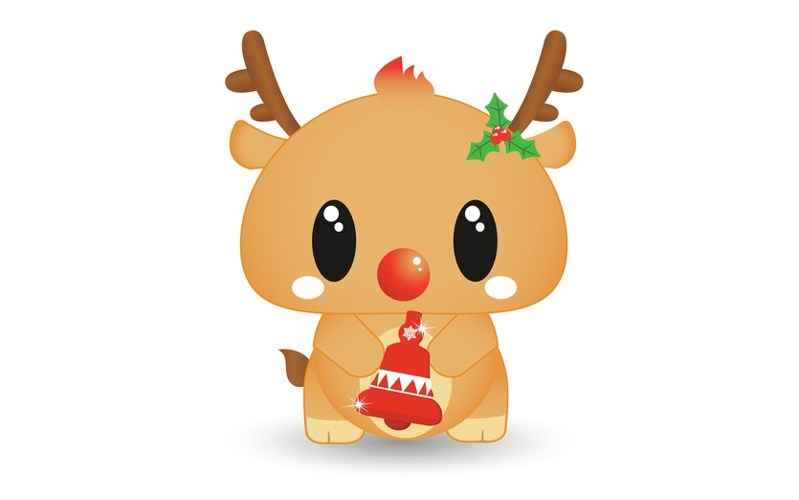
Make my wish come true
All I want for Christmas is you
I won't ask for much this Christmas
I won't even wish for snow, and I
I just wanna keep on waiting
Underneath the mistletoe

Slide 5
I won't make a list and send it
To the North Pole for Saint Nick
I won't even stay awake
To hear those magic reindeer click
'Cause I just want you here tonight
Holding on to me so tight
What more can I do
Oh, Baby all I want for Christmas is you

Slide 6
All the lights are shining
So brightly everywhere
And the sound of children’s
Laughter fills the air
And everyone is singing
I hear those sleigh bells ringing
Santa won't you bring me
The one I really need
Won't you please bring my baby to me

Slide 7
I don't want a lot for Christmas
This is all I'm asking for
I just wanna see my baby
Standing right outside my door
I just want you for my own
More than you could ever know
Make my wish come true

Slide 8
Baby all I want for Christmas is you, ooh baby
All I want for Christmas is you, baby
(All I want for Christmas is you, baby)
This Photo by Unknown Author is licensed under CC BY-SA-NC

Slide 9
Your Score:
99
Thank you for trying Pauline’s Videoke!!

