Slide 1
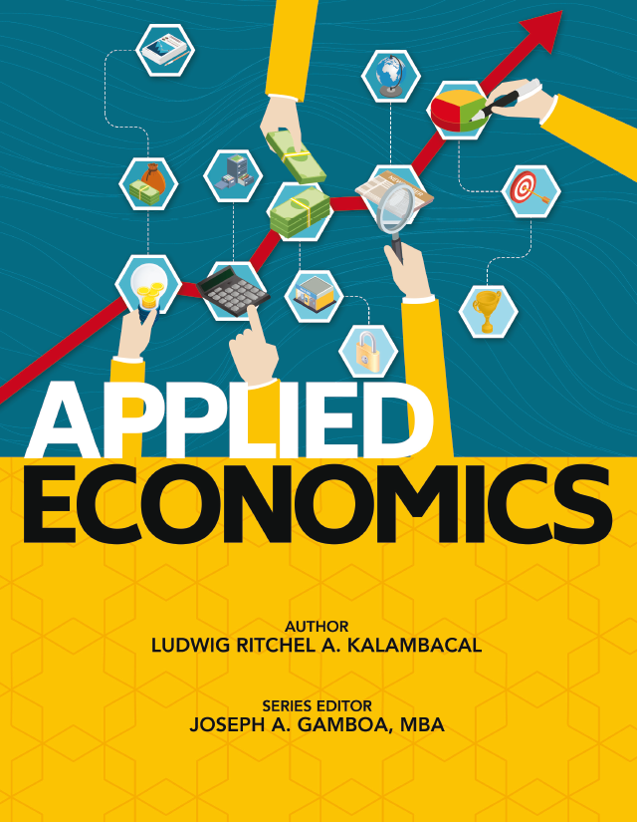
M1L5

Slide 2
Lesson 5: What are the Economic Developments in the Philippines in the 21st Century?
TARGET
Know the extent and limitation of foreign investments in the Philippines
Know the important political and market reforms that shaped the Philippine economy
Differentiate the main economic sectors and identify the major growth drivers in each sector
Identify significant contributors to Philippine economic growth

Slide 3
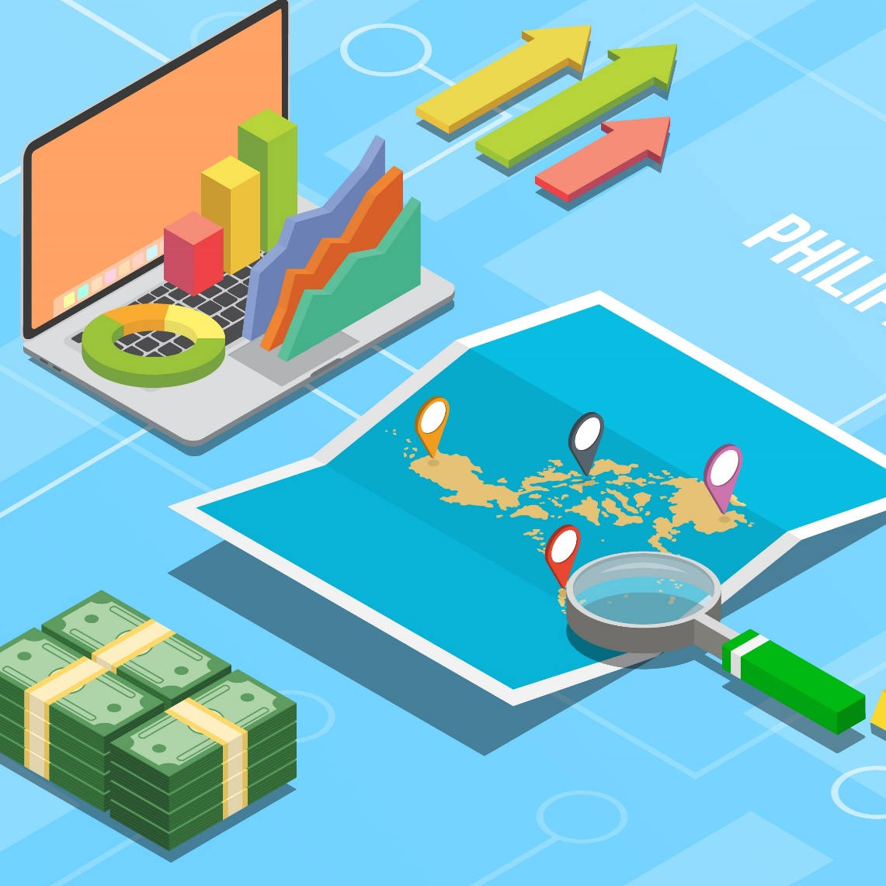
APPLIED ECONOMICS
Lesson 5: What are the Economic Developments in the Philippines in the 21st Century?
Overview of Economic Restrictions in the Philippine Constitution
The Philippines has become one of the fastest-growing economies in the Southeast Asian region, establishing above 6-percent economic growth from 2012 to 2019. However, Philippine economy is also characterized by economic restrictions, particularly on foreign ownership limitations.

Slide 4
APPLIED ECONOMICS
Lesson 5: What are the Economic Developments in the Philippines in the 21st Century?
Overview of Economic Restrictions in the Philippine Constitution
Article XII of the 1987 Philippine Constitution outlines the country’s restrictive economic provisions. It prohibits foreigners from possessing lands, exploiting natural resources, and operating commercial deep-sea vessels. It also does not allow them to have equity in mass media, own public utilities, and practice their professions.

Slide 5
APPLIED ECONOMICS
Lesson 5: What are the Economic Developments in the Philippines in the 21st Century?
Overview of Economic Restrictions in the Philippine Constitution
Foreigners who wish to engage in business in the Philippines should refer to the Foreign Investment Negative List (FINL) which lists down the economic activities they can participate in the country.
List A of the FINL pertains to foreign ownership restriction due to the mandate of the Constitution and other specific laws.

Slide 6
APPLIED ECONOMICS
Lesson 5: What are the Economic Developments in the Philippines in the 21st Century?
Overview of Economic Restrictions in the Philippine Constitution
List A of the FINL pertains to foreign ownership restriction due to the mandate of the Constitution and other specific laws.

Slide 7
APPLIED ECONOMICS
Lesson 5: What are the Economic Developments in the Philippines in the 21st Century?
Overview of Economic Restrictions in the Philippine Constitution
List B of the FINL pertains to foreign ownership restriction for reasons of security, defense, risks to health and morals, and protection of small- and medium-scale enterprises.

Slide 8
APPLIED ECONOMICS
Lesson 5: What are the Economic Developments in the Philippines in the 21st Century?
Overview of Economic Restrictions in the Philippine Constitution
It also contains an Annex on Professions. This serves as a guide for foreigners who want to practice their profession in the Philippines.

Slide 9
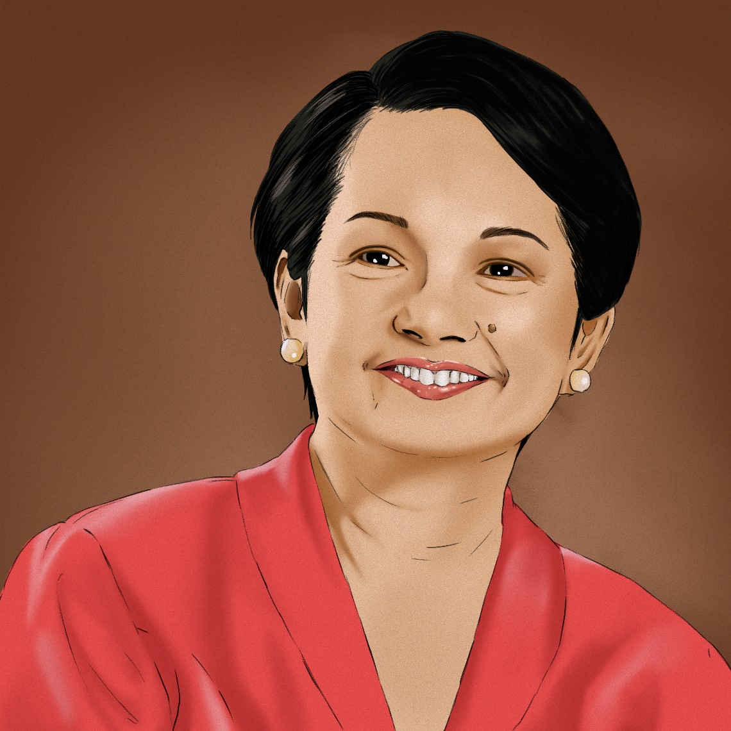
APPLIED ECONOMICS
Lesson 5: What are the Economic Developments in the Philippines in the 21st Century?
Significant Economic Reforms in the Philippines in the 21st Century
Under the Administration of Gloria Macapagal-Arroyo Emergence of Overseas Filipino Workers (OFW) and Business Process Outsourcing (BPO) industry. OFW remittances and BPO activities drove investment growth, particularly in the real estate sector.
Former President Gloria Macapagal-Arroyo

Slide 10
APPLIED ECONOMICS
Lesson 5: What are the Economic Developments in the Philippines in the 21st Century?
Significant Economic Reforms in the Philippines in the 21st Century
Under the Administration of Gloria Macapagal-Arroyo Electric Power Industry Reform Act (EPIRA) was approved into law in 2001. EPIRA aims to reduce the restrictions on the country’s electricity sector by deregulating the power generation industry. This created the Wholesale Electricity Spot Market (WESM) and introduced retail competition.
Former President Gloria Macapagal-Arroyo

Slide 11
APPLIED ECONOMICS
Lesson 5: What are the Economic Developments in the Philippines in the 21st Century?
Significant Economic Reforms in the Philippines in the 21st Century
Under the Administration of Gloria Macapagal-Arroyo Imposition of expanded value-added tax (E-VAT) on sales and importations. This was designed to improve government revenue and address large fiscal deficits.
Former President Gloria Macapagal-Arroyo

Slide 12
APPLIED ECONOMICS
Lesson 5: What are the Economic Developments in the Philippines in the 21st Century?
Significant Economic Reforms in the Philippines in the 21st Century
Under the Administration of Gloria Macapagal-Arroyo Implementation of holiday economics, which involves the changing of days in which to celebrate certain holidays to increase domestic tourism through long weekends.
Former President Gloria Macapagal-Arroyo

Slide 13
APPLIED ECONOMICS
Lesson 5: What are the Economic Developments in the Philippines in the 21st Century?
Significant Economic Reforms in the Philippines in the 21st Century
Under the Administration of Gloria Macapagal-Arroyo Launched the Pantawid Pamilyang Pilipino Program (4Ps) as part of its poverty alleviation efforts. The program provided conditional cash grants to the poorest of the poor for their children’s health, nutrition, and education needs.
Former President Gloria Macapagal-Arroyo

Slide 14
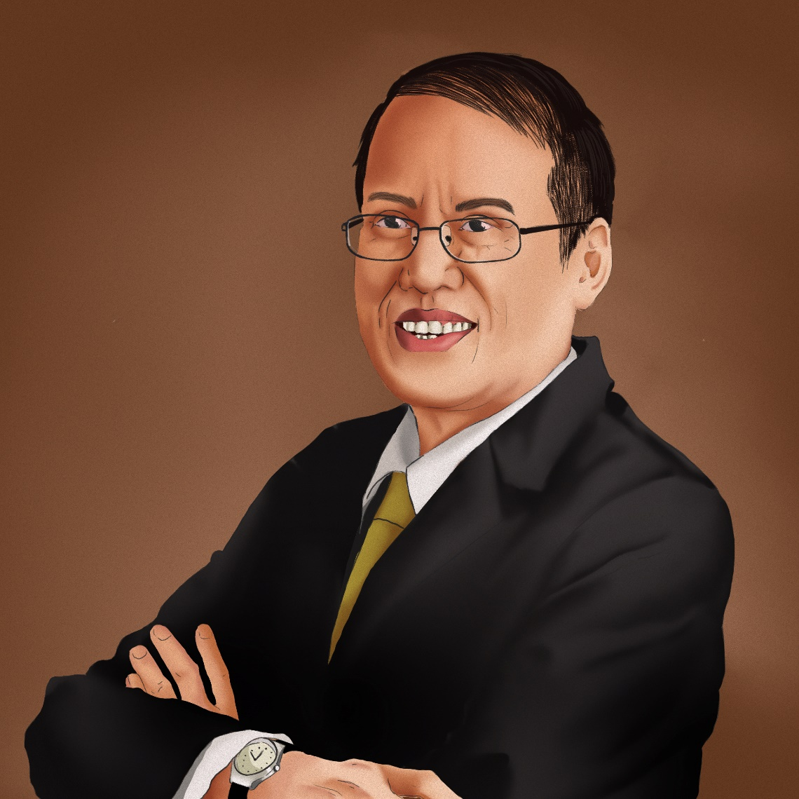
APPLIED ECONOMICS
Lesson 5: What are the Economic Developments in the Philippines in the 21st Century?
Significant Economic Reforms in the Philippines in the 21st Century
Under the Administration of Benigno Aquino III The continual growth of OFW remittances and BPO activities, as well as real estate investments, propelled the economy higher. The Philippines was classified as a newly industrialized country during this period, when our economy attained investment grade status given by international credit rating agencies starting 2013.
Former President Benigno Aquino III

Slide 15
APPLIED ECONOMICS
Lesson 5: What are the Economic Developments in the Philippines in the 21st Century?
Significant Economic Reforms in the Philippines in the 21st Century
Under the Administration of Benigno Aquino III Full entry of foreign banks into the Philippines was allowed in 2014. Foreign banks could either own 100 percent of domestic banks or facilitate their entry in the country. This was done to spur competition and give Filipinos a better choice to borrow and save money.
Former President Benigno Aquino III

Slide 16
APPLIED ECONOMICS
Lesson 5: What are the Economic Developments in the Philippines in the 21st Century?
Significant Economic Reforms in the Philippines in the 21st Century
Under the Administration of Benigno Aquino III Introduced the Philippine Competition Act to level the economic playing field by prohibiting anti-competitive deals, mergers, and acquisitions that restrict market competition.
Former President Benigno Aquino III

Slide 17
APPLIED ECONOMICS
Lesson 5: What are the Economic Developments in the Philippines in the 21st Century?
Significant Economic Reforms in the Philippines in the 21st Century
Under the Administration of Benigno Aquino III Enacted the Foreign Ships Co-Loading Act, which amended the 50-year-old Cabotage law. The act allows foreign vessels carrying cargoes for import or export to dock in multiple ports in the country, thereby reducing logistic costs for producers and market prices for consumers.
Former President Benigno Aquino III

Slide 18
APPLIED ECONOMICS
Lesson 5: What are the Economic Developments in the Philippines in the 21st Century?
Significant Economic Reforms in the Philippines in the 21st Century
Under the Administration of Benigno Aquino III Approved the implementation of the K to 12 Program in 2013 which aims to give students adequate time to understand the concepts and learn the skills by adding two years in the country’s basic education.
Former President Benigno Aquino III

Slide 19
APPLIED ECONOMICS
Lesson 5: What are the Economic Developments in the Philippines in the 21st Century?
Significant Economic Reforms in the Philippines in the 21st Century
Under the Administration of Rodrigo Roa Duterte A significant part of his economic agenda is the Build, Build, Build massive infrastructure program, which listed down high-impact infrastructure projects.
Former President Rodrigo Roa Duterte

Slide 20
APPLIED ECONOMICS
Lesson 5: What are the Economic Developments in the Philippines in the 21st Century?
Significant Economic Reforms in the Philippines in the 21st Century
Under the Administration of Rodrigo Roa Duterte Signed into law the Tax Reform for Acceleration and Inclusion (TRAIN) Act, the initial package of the Comprehensive Tax Reform Program (CTRP). The CTRP seeks to make the tax system simpler, fairer, and more efficient.
Former President Rodrigo Roa Duterte

Slide 21
APPLIED ECONOMICS
Lesson 5: What are the Economic Developments in the Philippines in the 21st Century?
Significant Economic Reforms in the Philippines in the 21st Century
Under the Administration of Rodrigo Roa Duterte The second CTRP package, the Corporate Recovery and Tax Incentives for Enterprises (CREATE) bill, aims to gradually lower corporate income taxes starting 2021, eventually bringing down the current 30 percent to 20 percent by 2029.
Former President Rodrigo Roa Duterte

Slide 22
APPLIED ECONOMICS
Lesson 5: What are the Economic Developments in the Philippines in the 21st Century?
Significant Economic Reforms in the Philippines in the 21st Century
Under the Administration of Rodrigo Roa Duterte Other significant economic reform measures include the Rice Tariffication Act to bring down rice prices, Ease of Doing Business Act to make government transactions faster, and New Central Bank Act to align the Bangko Sentral ng Pilipinas (BSP) further with international best practices.
Former President Rodrigo Roa Duterte

Slide 23
APPLIED ECONOMICS
Lesson 5: What are the Economic Developments in the Philippines in the 21st Century?
Significant Economic Reforms in the Philippines in the 21st Century
Under the Administration of Rodrigo Roa Duterte Before COVID-19, the economy under the Duterte Administration was doing well in terms of growth and stability. Its implementation of difficult economic reform measures has earned the country an investment-grade rating of BBB+ from international debt watcher S&P Global.
Former President Rodrigo Roa Duterte

Slide 24
APPLIED ECONOMICS
Lesson 5: What are the Economic Developments in the Philippines in the 21st Century?
Major Growth Drivers of the Philippine Economy
In the primary sector, the animal production industry leads the sector in terms of productivity and number of establishments. Growing perennial crops generates the highest employment and highest value of output. Support activities for agriculture and post-harvest crop activities pay the highest average annual compensation.

Slide 25
APPLIED ECONOMICS
Lesson 5: What are the Economic Developments in the Philippines in the 21st Century?
Major Growth Drivers of the Philippine Economy
In the secondary sector, manufacturing comprises more than half of the industrial sector. Baking leads the manufacturing sector in terms of the number of establishments. Manufacturing of semiconductor devices and electronic components generates the highest employment, value of output, and productivity.

Slide 26
APPLIED ECONOMICS
Lesson 5: What are the Economic Developments in the Philippines in the 21st Century?
Major Growth Drivers of the Philippine Economy
In the secondary sector, manufacturing of parts and accessories for motor vehicles receives the highest subsidy. Manufacturing of fertilizers and nitrogen compounds records the highest e-commerce sales. In the construction industry, Construction of buildings has the highest number of establishments followed by the construction of roads and railways.

Slide 27
APPLIED ECONOMICS
Lesson 5: What are the Economic Developments in the Philippines in the 21st Century?
Major Growth Drivers of the Philippine Economy
In the tertiary sector, the BPO industry remains to be the largest and fastest-growing industry based on revenues, with customer relationship management activities generating the highest income and most number of employees. As for the real estate industry, activities with owned or leased property contribute the major share to total income and employs majority of the workers.

Slide 28
APPLIED ECONOMICS
Lesson 5: What are the Economic Developments in the Philippines in the 21st Century?
Major Growth Drivers of the Philippine Economy
In the tertiary sector, the tourism industry remains vibrant as foreign visitor arrivals have already reached 6-million in 2019. For other service activities, personal services for wellness activities dominate the sector in terms of the number of establishments, number of workers, and total income.

Slide 29
APPLIED ECONOMICS
Lesson 5: What are the Economic Developments in the Philippines in the 21st Century?
Major Growth Drivers of the Philippine Economy
Other major contributors to the growth of the Philippine economy are the OFWs. The Philippines is a primary source of human resources in the global labor market. Moreover, the Philippines is among the top remittance recipients in the world. According to the World Bank, the Philippines ranked fourth globally in remittance received with $34-billion in 2018.

Slide 30
APPLIED ECONOMICS
Lesson 5: What are the Economic Developments in the Philippines in the 21st Century?
Major Growth Drivers of the Philippine Economy
The Philippine Offshore Gaming Operators (POGOs) are online gambling firms that operate in the country but cater to customers outside the Philippines. There are already 56 POGOs operating in the country as of June 2019, employing more than 130,000 individuals. From 2016 to 2018, these POGOs have contributed almost Php12-billion to the Philippine economy.

Slide 31
Major Growth Drivers of the Philippine Economy
The micro, small, and medium enterprises (MSMEs) have also played a very important role in the growth of the Philippine economy. The Philippine Statistics Authority (PSA) uses employment size in classifying an enterprise, while the inter-agency Small and Medium Enterprise Development Council (SMEDC) employs asset size as its basis for classification.
APPLIED ECONOMICS
Lesson 5: What are the Economic Developments in the Philippines in the 21st Century?

Slide 32
APPLIED ECONOMICS
Lesson 5: What are the Economic Developments in the Philippines in the 21st Century?
Measuring the Philippine Economy
Philippine economy can also be expressed by its gross national product (GNP) or gross domestic product (GDP). GNP is a broad measure of the country’s total economic activity. It takes into account the value of all finished goods and services produced in a given period by Filipino nationals here and abroad. GDP, a better indicator for gauging the size of an economy, takes into account the value of all final goods and services produced within the Philippines in a given period. It includes the output of foreign-owned businesses located in the country. There are three ways of computing for the value of GNP and GDP—all of which should total to the same amount:

Slide 33
APPLIED ECONOMICS
Lesson 5: What are the Economic Developments in the Philippines in the 21st Century?
Measuring the Philippine Economy
The value-added approach measures the GDP from the supply side of the market.
To compute for the GDP, simply take into account the value added from each of the main economic sectors:
Now, to get the GNP, simply add the net foreign factor income (NFFI):
The NFFI, also net primary income from the rest of the world, is the difference between the factor income earned from by citizens of a country abroad and the factor income earned by foreigners in that country.

Slide 34
APPLIED ECONOMICS
Lesson 5: What are the Economic Developments in the Philippines in the 21st Century?
Measuring the Philippine Economy
The expenditure approach is the most common way of calculating the country’s GNP and GDP. The GNP and GDP are identified as “Y” in this equation form.
Here is the formula for GDP:
where: C = Consumption I = Investment G = Government Expenditure x = Exports m = Imports

Slide 35
APPLIED ECONOMICS
Lesson 5: What are the Economic Developments in the Philippines in the 21st Century?
Measuring the Philippine Economy
For the GNP, here is the equation:
where: C = Consumption I = Investment G = Government Expenditure x = Exports m = Imports Z = NFFI
The net export is the difference between a country’s total value of exports and imports. It is expressed as (x – m) in the Expenditure Approach. If the net export is positive, the country has a trade surplus or a positive trade balance. Conversely, if the net export is negative, the country has a trade deficit or a negative trade balance.

Slide 36
APPLIED ECONOMICS
Lesson 5: What are the Economic Developments in the Philippines in the 21st Century?
Measuring the Philippine Economy
The income approach is based on the accounting principle that all expenditures in an economy should equal the total income generated by the production of all economic goods and services.
Here is the formula for GDP:
where: Wages = Salaries or earnings received from employment or rendering work Interest Income = Earned from holding interest-bearing assets or funds in banks Profit = Earned from investments, like stock dividends Rental Income = Earned from owning and renting properties
For calculating the GNP, here is the equation:

