Slide 1
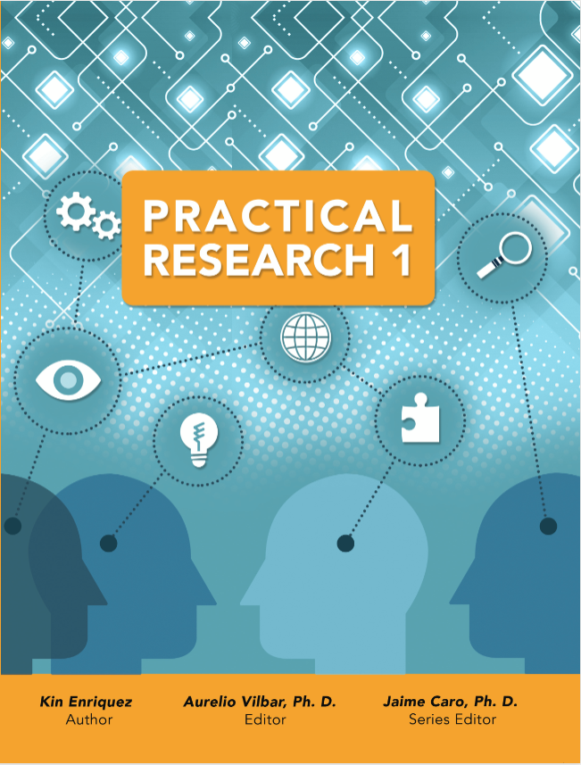
M1L1

Slide 2
Lesson 1: What is Research and its significance?
TARGET
Define what research is
Identify the significance and uses of research
Understand several forms of research
Introduce reasons for conducting qualitative research

Slide 3
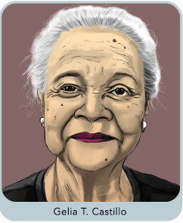
Lesson 1: What is Research and its significance?
PRACTICAL RESEARCH 1
WHAT IS RESEARCH?
GELIA T. CASTILLO
A distinguished rural sociologist
Was conferred the title of National Scientist in 1999
Conducted pioneering research on agricultural production system, farmer credit, women empowerment, economic inequality, and health concerns.
Provided a voice for many underprivileged rural farmers and households and sought to narrow inequalities in Philippine society through her research.

Slide 4
Lesson 1: What is Research and its significance?
PRACTICAL RESEARCH 1
WHAT IS RESEARCH?
Research - involves a careful and systematic collection and analysis of information to produce or enhance our knowledge and understanding of a subject matter or topic of interest.
- plays a crucial role in the advancement of knowledge, ideas, and theories in virtually all fields of endeavor.

Slide 5
Lesson 1: What is Research and its significance?
PRACTICAL RESEARCH 1
FORMS OF RESEARCH
Scientific Research
Designed to learn about the physical world and discover how it works.
It includes fields such as physics, chemistry, biology, astronomy, computer science, computer engineering, artificial intelligence, and cryptography.
Social sciences and humanities
Encompass studies that deal with human society, culture, and the interaction and relationships between its members.
It includes branches like anthropology, sociology, communication studies, area studies, linguistics, demography, and geography.

Slide 6
Lesson 1: What is Research and its significance?
PRACTICAL RESEARCH 1
FORMS OF RESEARCH
Historical research
Pertains to events in the past and the interpretation of such events.
Historical methods are the techniques and methods used for this study.
Business research
Conducted to solve business and management problems.
Non-empirical research
Includes theoretical studies related to cosmological phenomena and mathematics.

Slide 7
Lesson 1: What is Research and its significance?
PRACTICAL RESEARCH 1
INTEGRATE
In what aspects of your daily life do you use research? How is it useful for you and those around you?

Slide 8
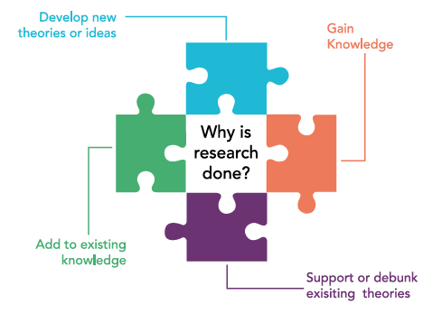
Lesson 1: What is Research and its significance?
PRACTICAL RESEARCH 1
WHY IS RESEARCH DONE?
To gain new knowledge
To add to the existing knowledge
To support or debunk existing theories
To develop new theories or ideas

