Slide 1
World Heritage Sites in the Philippines
Legacies of the Country

Slide 2
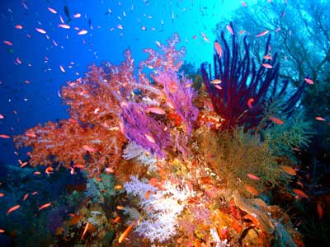
Tubbataha Reefs Natural Park

Slide 3
Tubbataha Reefs Natural Park
Declared a World Heritage Site in 1993
Located in Cagayancillo, Palawan
The only marine natural park in the country
A protected area under the UNEP
Notes:
Insert the following hyperlinks:
World Heritage Site – http://whc.unesco.org/en/list/653
marine natural park – http://www.tubbatahareef.org/
For “protected area” in the fourth bullet entry, locate “UNEP Tubbataha Reefs Natural Park.pdf” in the CD.

