Slide 1
World Heritage Sites in the Philippines
Legacies of the Country

Slide 2
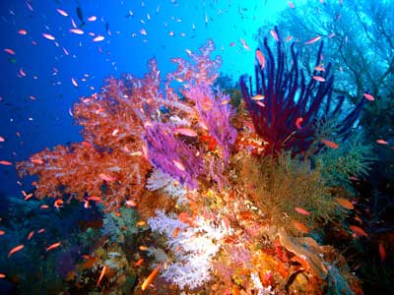
Tubbataha Reefs Natural Park

Slide 3
Tubbataha Reefs Natural Park
Declared a World Heritage Site in 1993
Located in Cagayancillo, Palawan
The only marine natural park in the country
A protected area under the UNEP
Notes:
Insert the following hyperlinks:
World Heritage Site – http://whc.unesco.org/en/list/653
marine natural park – http://www.tubbatahareef.org/
For “protected area” in the fourth bullet entry, locate “UNEP Tubbataha Reefs Natural Park.pdf” in the CD.

Slide 4
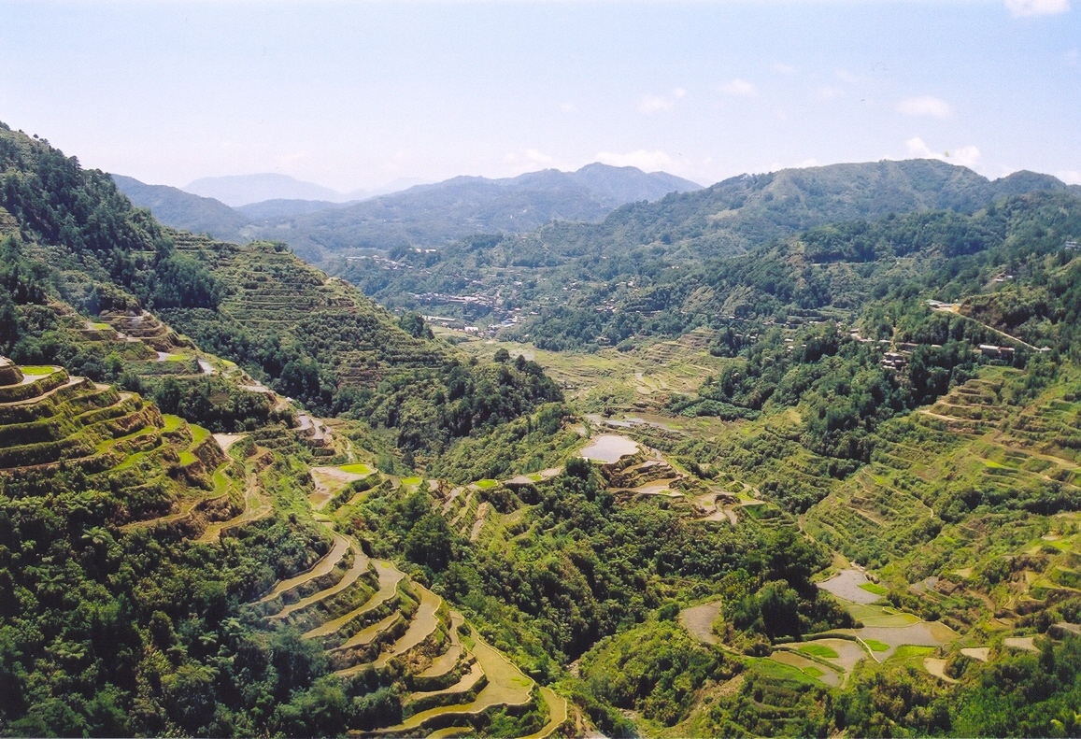
Cordillera Rice Terraces

Slide 5
Cordillera Rice Terraces
Declared a World Heritage Site in 1995
Located in Ifugao Province
Inscribed in the List of World Heritage in Danger in 2001
Notes:
Insert the following hyperlinks:
World Heritage Site – http://whc.unesco.org/en/list/722
List of World Heritage in Danger – http://whc.unesco.org/archive/repcom01.htm

Slide 6
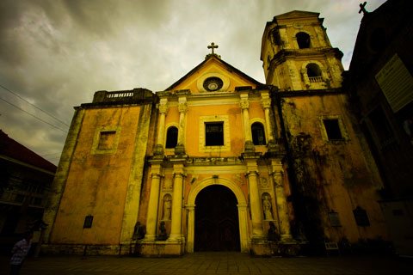
Baroque Churches
San Agustin Church in Intramuros, Manila

Slide 7
Baroque Churches
Declared World Heritage Sites in 1993
San Agustin Church in Intramuros, Manila
Nuestra Señora in Santa Maria, Ilocos Sur
San Agustin in Paoay, Ilocos Norte
Santo Tomas in Miag-ao, Iloilo
Spanish-era churches, with San Augustin, completed in 1606, as the oldest surviving church
For more information, visit the Web site of the Heritage Conservation Society.
Notes:
Insert the following hyperlinks:
World Heritage Site – http://whc.unesco.org/en/list/677
Web site of the Heritage Conservation Society – http://heritageconservation.wordpress.com/2006/07/29/san-agustin-church-intramuros-manila/

